Slide 1
Digital Portfolio
STUDENT NAME : Ashwini S
REGISTER NO AND NMID : asunm1451222407464
DEPARTMENT : BSC Computer Science
COLLEGE: COLLEGE/ UNIVERSITY :MAHALASHMI WOMEN’S
COLLEGE OF ARTS AND SCIENCE

Slide 2
PROJECT TITLE : DIGITAL PORTFOLI0

Slide 3


AGENDA
Problem Statement
Project Overview
End Users
Tools and Technologies
Portfolio design and Layout
Features and Functionality
Results and Screenshots
Conclusion
Github Link
3/21/2024 Annual Review

Slide 4

PROBLEM STATEMENT 1. Problem Statement In the digital era, students often lack a structured and professional medium to represent their skills and accomplishments. 2 . Conventional resumes are static and fail to demonstrate creativity, problem-solving ability, and technical expertise. 3. This creates a gap between students and recruiters/academicians, making it difficult to assess overall competencies.

Slide 5

PROJECT OVERVIEW 1. Project Overview The Student Digital Portfolio is a web-based platform designed to present student profiles in an interactive and visually appealing manner. 2. It integrates academic details, technical skills, project work, and achievements into a single accessible space. 3. The solution emphasizes personal branding and enhances employability opportunities.

Slide 6

WHO ARE THE END USERS? Students → To highlight skills, creativity, and career readiness. Recruiters/Employers → To evaluate potential candidates efficiently. Teachers & Mentors → To assess student performance and progress. Academic Institutions → To showcase the quality and achievements of their students

Slide 7

TOOLS AND TECHNIQUE 1. Technologies Used:HTML, CSS, JavaScript for frontend development. 2. Bootstrap / Tailwind CSS for responsive layouts. 3. Design Tools: Canva, Figma for UI/UX design. 4. Version Control & Hosting: GitHub, Netlify for deployment . 5. Documentation & Presentation: MS PowerPoint, Google Slides.

Slide 8
POTFOLIO DESIGN AND LAYOUT
Sections Included:
Profile & Introduction
Academic Background
Skills Matrix
Projects & Achievements
Image/Video Gallery
Contact Information
Design Principles:
Minimalistic, professional, and responsive design.
User-friendly navigation with clear structure.
Consistent typography and color scheme.-
T
8

Slide 9
FEATURES AND FUNCTIONALITY Responsive Design → Optimized for desktop, tablet, and mobile. Interactive Project Showcase → Live demos, descriptions, and repositories. Resume Download Option → Quick access to CV in PDF format. Integrated Contact Form → Direct communication with recruiters. Social Media & GitHub Links → Expands professional networking. Gallery Section → Highlights extracurriculars and achievements.

Slide 10
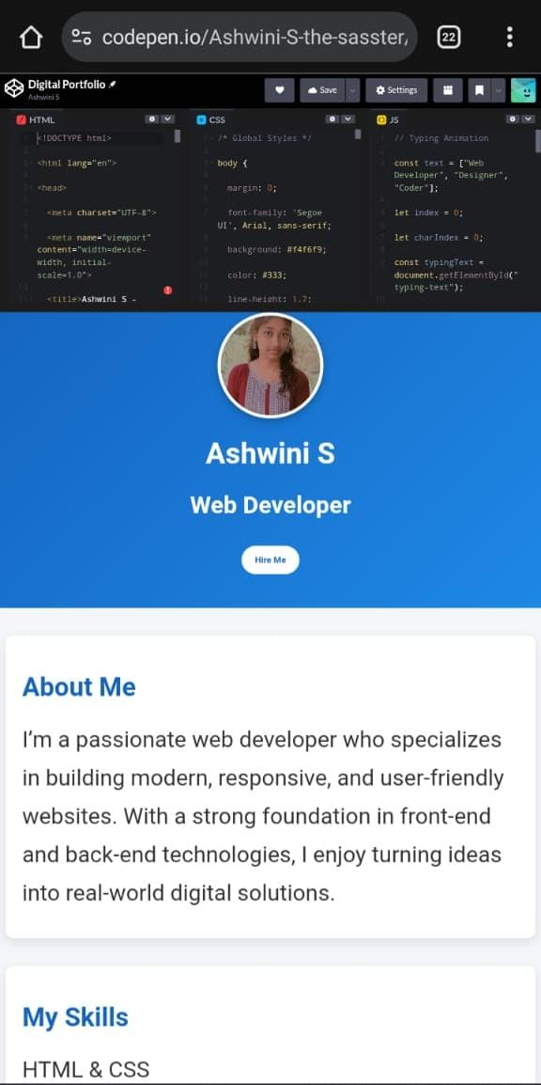

RESULTS AN SCREENSHOT 1.IMPROVED STUDENT VISIBILITY FOR RECRUITERS 2. PROFESIONAL PRESENTATION OF SKILLS AND achievements
3/21/2024 Annual Review
10

Slide 11
CONCLUSION The Student Digital Portfolio serves as a modern and professional platform that enables students to present their skills, projects, and achievements in a structured and engaging way. It enhances personal branding, improves visibility and credibility, and provides a competitive edge in internships, placements, and higher education opportunities. By offering global accessibility and interactive features, it bridges the gap between students and recruiters, making it an essential tool for success in today’s digital era.
11

